Slide 1
How (not) to Cripple the Baselines in Time Series Anomaly Detection
Eamonn Keogh: August 2021
Time series anomaly detection seems to suffer from very poor empirical evaluation. We previously noted that most of the benchmark datasets that are used in this domain are close to worthless¹.
Another common problem is the contriving the data/situation to make a popular strong baseline, time series discords apparently underperform in both efficiency and effectiveness.
To be clear, we are not suggesting that time series discords is the best solution in general. However, it is a strong baseline, worth comparing to because:
  It is very simple, one or zero² parameters, and implementable in a handful of lines of code.
  Discords have been shown to work well by at least several dozen independent teams… …observations of the magnetosphere collected by the Cassini spacecraft in orbit around Saturn.. ..in this case, the best-performing method was discords.. Wagstaf et. al. NASA JPL.2020
However, many papers make trivial mistakes in their understanding, that make time series discords look very slow and/or very ineffective.
In this short document, we address some of these issues:
  The twin freak problem
  The constant region problem
  The “too slow” problem
  The pathological parameter problem
  Crippling by definition
¹Renjie Wu, Eamonn J. Keogh: Current Time Series Anomaly Detection Benchmarks are Flawed and are Creating the Illusion of Progress. CoRR abs/2009.13807 (2020)
²Takaaki Nakamura, Makoto Imamura, Ryan Mercer, Eamonn J. Keogh: MERLIN: Parameter-Free Discovery of Arbitrary Length Anomalies in Massive Time Series Archives. ICDM 2020: 1190-1195

Slide 2
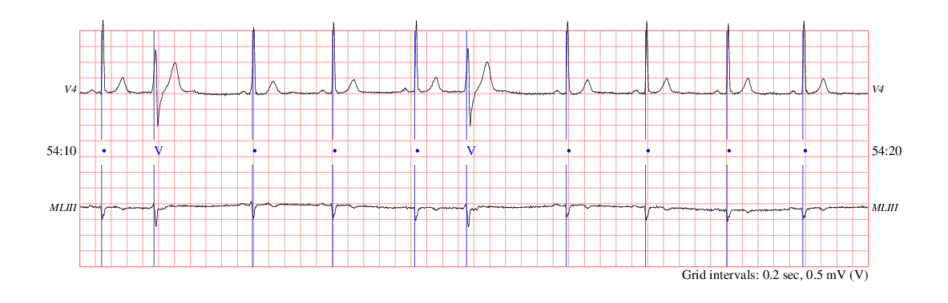
The Twin Freak “Problem”
Several research efforts claim that discords do not work well when there are two or more similar anomalies in the dataset…
¹“we observe that the anomalies do not correspond to the most distant NN .. This is because our dataset includes several anomalies that are similar to one another (i.e., of the same type).”
²“Being able to detect re-occurring patterns as anomalous is important”
However, I regard this as a non-issue (actually, that is a bit of an understatement)
Let's use this dataset to understand the issue: edbECG.txt
The time series starts here: record edb/e0103 , annotator atr, from 53:10.000 European ST-T Database (edb)
The dataset has two anomalies, both PVCs . So this is a nice example of “our dataset includes several anomalies that are similar to one another (i.e., of the same type).”
¹Paul Boniol, John Paparrizos, Themis Palpanas, Michael J. Franklin: SAND: Streaming Subsequence Anomaly Detection. Proc. VLDB Endow. 14(10): 1717-1729 (2021)
²Distributed detection of sequential anomalies in univariate time series. Johannes Schneider, Phillip Wenig & Thorsten Papenbrock The VLDB Journal volume

Slide 3
edbECG.txt
Because of the twin freak issue, the Matrix Profile does indeed fail to find the PVCs.
Instead, the strongest discord corresponds to a slightly shorter (but medically insignificant) beat.
Does this mean discords have this claimed twin freak flaw?
No! This is the batch case, and for each subsequence we can “look into the future”.
However, we typically want to find anomalous heartbeats online, not batch. We should not be able to see the future.
Lets redo this, and for each subsequence we only look into past. We can do this with leftMP, which is just a few lines of code (next slide).
1
PVCs are not top discords
15000
20
10
batch discords (Matrix Profile)
0
1
15000
>> interactiveMatrixProfileVer4_website( edbECG(10001:end) ,256);
If there is only one short beat, why are there two peaks associated with it?
Informally..
Consider the text analogy:
..atcatcatcatcatdogcatcatcatcatcatcatc..
At the scale of length 3, there is one anomaly ‘dog’.
At the scale of length 6, there are two anomalies ‘catdog’ and ‘dogcat’.
So, the two peaks here are [normalshort] and [shortnormal]
The left MP appears here, in a different context https://www.cs.ucr.edu/~eamonn/chains_ICDM.pdf

Slide 4
If we do online discords, the first occurrence of the PVC is strongly detected!
This take a just few lines of code (below).
Note that if we started reporting online discords immediately, we would report all the early subsequences as being very anomalous, as we have yet to see enough data. So here only start reporting after seeing the first 10000 datapoints
edbECG.txt
1
PVCs are not top discords
15000
20
10
batch discords (Matrix Profile)
0
1
15000
15
10
Solved!
Online discords (STAMPi)
5
0
0
0.5
1
1.5
2
2.5
4
10
Conclusion
The “twin freak” issue is not, and never really was a problem.
It is fixable by doing the above, or by considering the k^{th} nearest neighbor¹, or several other trivial ideas. Several papers contrived to make [a] or find datasets the exhibited this issue, but it is simply a non-issue.
[a] https://www.cs.ucr.edu/~eamonn/discord_sigkdd.pdf
¹A handful of papers noted this, but bemoaned the fact k was a parameter, then they went on to introduce an alternative with 3 or 4 parameters!
Did we fail to find the second anomaly? No, once we find the first, we can identify any subsequent occurrence.
>> leftMP(edbECG )
function leftMP(T)
SubsequenceLength = 256; % This is often 'm' in papers
CurrentIndex = 10000; % Start processing only after seeing 10000 points
Left_MP = zeros(size(T)); % This is a special Matrix Profile, it only looks left (backwards in time)
for i = CurrentIndex : length(T) - SubsequenceLength +1;
Left_MP(i) = min( MASS_V3(T(1:i), T(i:i+SubsequenceLength-1) , 256*8)); % all the data we have seen
end
figure;, hold on;, plot(Left_MP);, plot(zscore(T)-8,’r');
end

Slide 5



The Twin Freak “Problem” is Philosophically Meaningless
Rara avis in terris nigroque simillima cygno
When Willem de Vlamingh became the first European to see a black swan on the 10th January 1697, it was an anomaly. By the next day, when he had seen hundreds, black swans were no longer an anomaly.
Consider the dataset below used to justify twin freak invariant algorithms. Perhaps the first arrythmia can be considered an anomaly. But there are 132 more such beats. Is the 133rd such arrythmia still an “anomaly”?
No! In fact, you could argue the opposite. If we had twenty seconds without such an arrythmia, then that would be a stunning anomaly.
This misguided focus on this trivially solvable pseudo-problem has wasted much of the energy of the community¹.
Decimus Junius Juvenalis
First anomaly
Twin freak
Triple freak
MBA805 (excerpt)
0
1000
2000
3000
4000
5000
6000
7000
8000
9000
10000
¹https://www.cs.ucr.edu/~eamonn/discord_sigkdd.pdf
A trivial snippet of code to discover these anomalies is in Case Study I, below in this document.

Slide 6
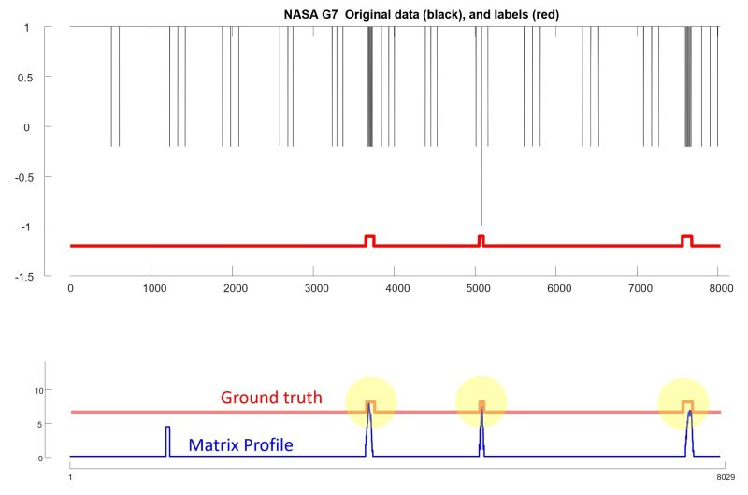
The Constant Region “Problem” I
Some datasets, like this NASA G7 dataset, have constant regions that are longer than the subsequence length.
Recall that we normally compute discords in z-normalized space, so a constant region is undefined (div-zero).
What actually happens depends on the implementation.
For the MP implementation used here, the MP profile does have undefined regions, and the largest value is a false positive ;-(
We can fix this elegantly in the MP code. However, to show how simple it is to fix this, let me show you this “hack” trick.
I am going to add a tiny (1 part in a million) linear trend to the data, like this:
>> interactiveMatrixProfileVer4_website( G7 +[1:length(G7)]'/1000000 ,50);
That completely solves the problem, and the top three discords are now all true positives.
The latest version of MERLIN does this automatically for you. For the Matrix Profile, you should do it yourself.
10
Blank regions are undefined
5
0
10
5
Problem solved!
0
8029

Slide 7
The (near) Constant Region “Problem” II
1
5001
Consider this simple dataset, where we correctly find the PVC anomaly
>> interactiveMatrixProfileVer4_website( edbECG(11000:16000) ,200);
Now let me prepend some very low amplitude noise. It is so low amplitude that it looks almost constant, but it is not a true constant.
Here is a zoom-in
Now the low amplitude region is the anomaly.
What happened?
When you z-normalize the very low amplitude noise it “expands” in amplitude, like this ->
Such high amplitude noisy regions are maximally far from all other subsequences (including other high amplitude noisy subsequences).
Such very low amplitude near constant regions are common in many datasets. However, such regions are also trivially easy to detect and remove.
25
Top discord
20
15
10
5
0
1
5001
very low amplitude noise
1
5501
25
New top discord
20
15
10
5
0
1
5501
100
80
60
40
plot(movstd(x,200))
20
0
0
1000
2000
3000
4000
5000
>> x=[rand(1,500) edbECG(11000:16000) ]; % detect
>> x((movstd(x,200)<1))=[]; % removed
>> interactiveMatrixProfileVer4_website( x ,200);
Problem solved
20
1
5100
10
0
1
5100
A real world example of this can be found in trace 3 of https://github.com/NetManAIOps/OmniAnomaly/blob/master/ServerMachineDataset/test/machine-3-10.txt

Slide 8
The “too slow” problem
Many papers conflate Discords and the Matrix Profile.
It is true that the Matrix Profile algorithms (STOMP, STAMP, SCRIMP) can be used to compute discords.
However, much faster algorithms are available², and they have been around for well over a decade¹. (I recommend ²)
In almost all real-world settings, you can find discords much faster than real time.
Let's revisit our ECG example, assume it was sampled at 256hz. Lets add in some code to see how long it takes to process each second..
On an old slow laptop, with unoptimized code³, we can ingest 256hz about twenty times faster than real-time.
With a little more effort, one hundred times faster than real-time is easy to obtain.
Conclusion: Don’t confuse Discords and the Matrix Profile.
>> leftMP(edbECG )
I have just processed one seconds worth of data
Elapsed time is 0.043763 seconds.
I have just processed one seconds worth of data
Elapsed time is 0.047450 seconds.
I have just processed one seconds worth of data
Elapsed time is 0.047634 seconds.
I have just processed one seconds worth of data
Elapsed time is 0.041712 seconds.
I have just processed one seconds worth of data
Elapsed time is 0.044042 seconds.
I have just processed one seconds worth of data
Elapsed time is 0.040123 seconds.
I have just processed one seconds worth of data
Elapsed time is 0.040306 seconds.
I have just processed one seconds worth of data
Elapsed time is 0.041146 seconds.
I have just processed one seconds worth of data
::::
function leftMP(T)
SubsequenceLength = 256; % This is often 'm' in papers
CurrentIndex = 10000; % Start processing only after seeing 10000 points
Left_MP = zeros(size(T)); % This is a special Matrix Profile, it only looks left (backwards in time)
tic
for i = CurrentIndex : length(T) - SubsequenceLength +1;
Left_MP(i) = min( MASS_V3(T(1:i), T(i:i+SubsequenceLength-1) , 256*8)); % all the data we have seen
if ~mod(i,256)
disp(["I have just processed one seconds worth of data"])
toc;
tic;
end
end
figure;, hold on;, plot(Left_MP);, plot(zscore(T)-8,'g');
¹Dragomir Yankov, Eamonn Keogh, and Umaa Rebbapragada (2007). Disk Aware Discord Discovery: Finding Unusual Time Series in Terabyte Sized Datasets. ICDM 2007.
²Takaaki Nakamura, Makoto Imamura, Ryan Mercer, Eamonn J. Keogh: MERLIN: Parameter-Free Discovery of Arbitrary Length Anomalies in Massive Time Series Archives. ICDM 2020: 1190-1195
³How can I optimize similarity search in a long time series? in https://www.cs.ucr.edu/~eamonn/100_Time_Series_Data_Mining_Questions__with_Answers.pdf

Slide 9
The pathological parameter problem
Time series discords require one parameter, the discord length. But see ²
The definition is very stable to changes to this parameter.
Below we plot the top discord as a red line, for every parameter from 30 to 300
For essentially every value from 50 to 300 the discords point to the true anomaly, the Atrial premature beat.
However, if we wanted to make discords look bad, we could use a pathologically short discord, say 34
Amazingly, many papers have done this. It is hard to see that this is an accident, if they can tune their 4 or 5 or 12 parameters, surely, they can find a reasonable value here.
pathologically short
Atrial premature beat
30
300
0.2
0.4
0.6
0.8
1
1.2
1.4
1.6
1.8
2
4
10
²Takaaki Nakamura, Makoto Imamura, Ryan Mercer, Eamonn J. Keogh: MERLIN: Parameter-Free Discovery of Arbitrary Length Anomalies in Massive Time Series Archives. ICDM 2020: 1190-1195

Slide 10
Crippling by Definition
Essentially any machine learning algorithm can be made to look bad by creating (or finding) a pathological worst case for it.
(A question I give in my u-grad AI class: Create two simple datasets, one that that give perfect accuracy for a decision tree, but default rate for 1NN, and vice versa).
While it is great to be aware of pathological cases, there is clearly the potential to be disingenuous with this.
Below is a pathological example for time series discords.
The anomaly is the sine wave with an unexpected reduction in noise. Discord will not find these. However..
Such anomalies (changes in mean, standard deviation, noise level) are easy to find with 60-year-old ideas.
Such anomalies do seem to be rare in the real world.
We would suggest..
By all means point out limitations and invariances of various methods.
Consider and acknowledge the limitations and invariances of your proposed method.
991
5
0
1
991
0
100
200
300
400
500
600
700
800
900
1000
Matrix Profile V: A Generic Technique to Incorporate Domain Knowledge into Motif Discovery. Hoang Anh Dau and Eamonn Keogh.
Trivial solution plot(movmin(movstd(x,30),30)<0.3,’g’);

Slide 11
Conclusions
We do not claim
    Discords are the “final word” on anomaly detection.
    Discords are the only definition that gets crippled by the community.
However, it is clear that many recent papers that position themselves as being faster or better than discords are making ill-supported claims.
The community would benefit from more careful introspection.

Slide 12
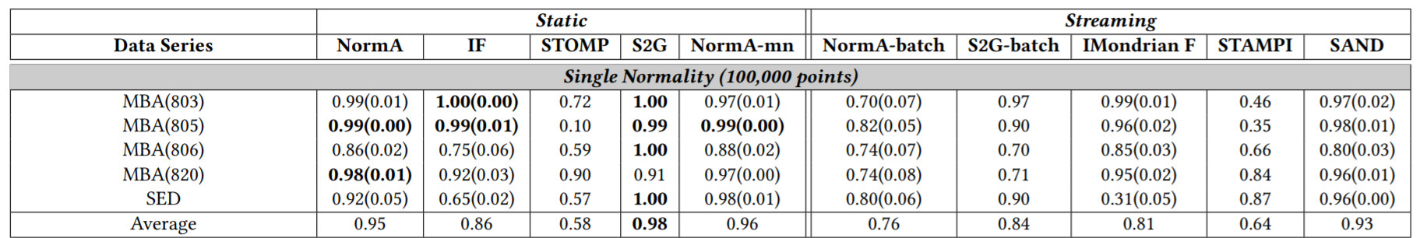
Case Study I
A recent paper managed to find some datasets that have twin freaks, and thus make discords perform poorly.
The “hardest” case is MBA805. Is MBA805 really a hard problem? Lets run some code to see >> leftMP(MBAECG805(1:10000) )
15
Strong peak at first anomaly
10
5
0
First anomaly
Twin freak
Triple freak
0
1000
2000
3000
4000
5000
6000
7000
8000
9000
10000
It is a trivially easy problem to solve. Once you detect the first anomaly, you can monitor for other occurrences.
function leftMP(T)
SubsequenceLength = 128; % This is often 'm' in papers
CurrentIndex = 600; % Start processing only after seeing 600 points
Left_MP = zeros(size(T)); % This is a special Matrix Profile, it only looks left (backwards in time)
for i = CurrentIndex : length(T) - SubsequenceLength +1;
Left_MP(i) = min( MASS_V3(T(1:i), T(i:i+SubsequenceLength-1) , 256*8)); % all the data we have seen
end
figure;, hold on;, plot(Left_MP);, plot(zscore(T)-8,'g');
end
¹Paul Boniol, John Paparrizos, Themis Palpanas, Michael J. Franklin: SAND: Streaming Subsequence Anomaly Detection. Proc. VLDB Endow. 14(10): 1717-1729 (2021)

Slide 13
Case Study II
What about the others in this collection? Yes, they are all trivial.
This one has an intermittent short QT beat as the anomaly
Strong peak at first anomaly
>> leftMP(MBAECG820(1:10000) )
First anomaly
Twin freak
Triple freak
Quadruple freak…
¹Paul Boniol, John Paparrizos, Themis Palpanas, Michael J. Franklin: SAND: Streaming Subsequence Anomaly Detection. Proc. VLDB Endow. 14(10): 1717-1729 (2021)

Slide 14
How to use Discords
There are many way to use discords on a dataset that has a train/test split.
You can..
  fullMP: Use only the training data
  fullMP: Use only the test data (surprisingly, this is often just as effective)
  fullMP: Use both train and test data
  leftMP: Use only the training data
  leftMP: Use only the test data
  leftMP: Use both train and test data
Which you should use depends on your assumptions/task at hand
If you will have twin freaks, you should use one of the leftMP options (but see slides above)
Let test them all on 133_UCR_Anomaly_InternalBleeding14_2800_5607_5634.txt It happens to be a very easy problem…
>> pig=UCRAnomalyInternalBleeding14280056075634;

Slide 15
  fullMP: Use only the training data
  >> interactiveMatrixProfileAB(pig ,100,2801);
  Note that this is an ABjoin. The last parameter, 2801, is the dividing line between A and B. So, the MP from 2801 to the end, reflects the distance of each subsequence in B (test data), to its nearest neighbor in B (train data).
1
7501
20
10
The first 2800 datapoints in the MP should be ignored
0
1
7501
fullMP: Use only the test data>> >>interactiveMatrixProfileVer4_website(pig(2801:end) ,100);
1
20
10
0
1
  fullMP: Use both train and test data
  >> interactiveMatrixProfileVer4_website(pig ,100);
1
7501
20
  As it happens, on this dataset, you get essentially the same results (it is a trivial problem)
10
0
1
7501

Slide 16
  leftMP: Use only the training data
function leftMP(T)
SubsequenceLength = 100; % This is often 'm' in papers
CurrentIndex = 2801+ 200; % Start processing only after seeing 200 points
Left_MP = zeros(size(T)); % This is a special Matrix Profile, it only looks left (backwards in time)
for i = CurrentIndex : length(T) - SubsequenceLength +1;
Left_MP(i) = min( MASS_V3(T(2801:i), T(i:i+SubsequenceLength-1) , 256*8)); % all the data we have seen
end
figure;, hold on;, plot(Left_MP,'b');, plot(zscore(T)-2,'r');
end
leftMP: Use only the test data
function leftMP(T)
SubsequenceLength = 100; % This is often 'm' in papers
CurrentIndex = 2801; % Start processing only after seeing 200 points
Left_MP = zeros(size(T)); % This is a special Matrix Profile, it only looks left (backwards in time)
for i = CurrentIndex : length(T) - SubsequenceLength +1;
Left_MP(i) = min( MASS_V3(T(1:2801), T(i:i+SubsequenceLength-1) , 256*8)); % all the data we have seen
end
figure;, hold on;, plot(Left_MP,'b');, plot(zscore(T)-2,'r');
end
leftMP: Use both train and test data
function leftMP(T)
SubsequenceLength = 100; % This is often 'm' in papers
CurrentIndex = 200; % Start processing only after seeing 200 points
Left_MP = zeros(size(T)); % This is a special Matrix Profile, it only looks left (backwards in time)
for i = CurrentIndex : length(T) - SubsequenceLength +1;
Left_MP(i) = min( MASS_V3(T(1:i), T(i:i+SubsequenceLength-1) , 256*8));
end
figure;, hold on;, plot(Left_MP,'b');, plot(zscore(T)-2,'r');
end
The first 2800 datapoints in the MP should be ignored
  As it happens, on this dataset, you get essentially the same results (it is a trivial problem)

